Slide 1
SHMD Report 250719
Adding Soil Amendments and Tahoma 31 to Two of Three New Trees on South Telluride Street and Progress Drive
Rick Shecter
7/19/2025

Slide 2
BACKGROUND:
This report reports on 2 tests to 3 new trees on South Telluride.
The northern-most tree is a Redmond Linden, the middle tree is a Kentucky Coffee tree, and the southern-most is a Greenspire Linden.
The first test involved adding 2 soil amendments: Texas Earth Bio Nectar soil microbes and Zumsil monosilicic acid formulation to the John Deere water tank, thus not only supplying water to the new trees but also improving the health of the soil and the trees.

Slide 3
BACKGROUND (cont.):
Instead of adding mulch around a tree, the second test involved adding 2 mats of Tahoma 31 grass from Scienturfic around the base of the 2 new Linden trees. We wanted to know the following: Would the grass hold and absorb more water than bare soil? Would the grass retain more water for the benefit of the tree roots? Would the grass cool the soil resulting in less water loss through the tree leaves (see SHMD Report 250701)? Would the dense leaf structure of the Tahoma 31 collect dew in the warm summer months?

Slide 4
ADDITIVE AND GRASS PROFILE: Bio Nectar is a dry powder containing a multitude of soil microorganisms that readily dissolve in water and supply micronutrients to grasses and trees. Two tablespoons of BioNectar were added to the 150-gallon water tank.
Zumsil adds silica in the form of a monosilicic acid to strengthen the structure of trees, increases soil microbial activity, and acts as a water dispersant to increase water infiltration and retention rates. Eight ounces were added to the 150-gallon tank.
Tahoma 31 is a hybrid bermudagrass developed at Oklahoma State University that requires less water, and can withstand Colorado’s drought-like summer conditions and freezing winters.

Slide 5
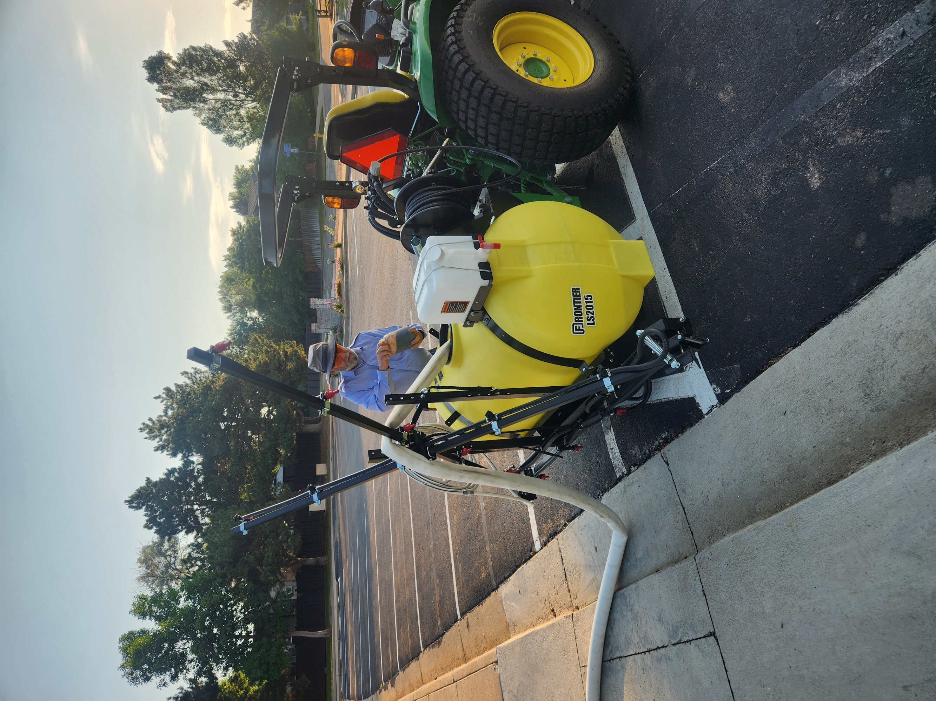
Thursday, July 17, Adding dissolved Bio Nectar and Zumsil to the 150-gallon water tank

Slide 6
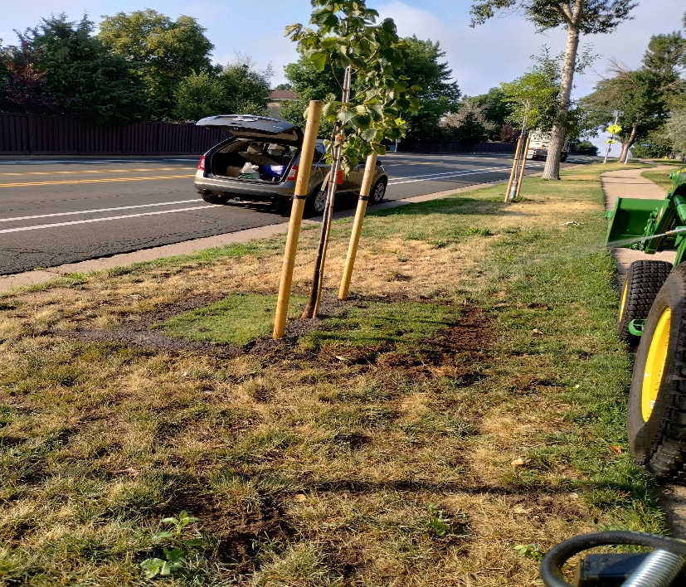
Thursday, July 17, Tahoma 31 grass mats planted next to Redmond Linden after removing 1 ½ inches of subsoil

Slide 7
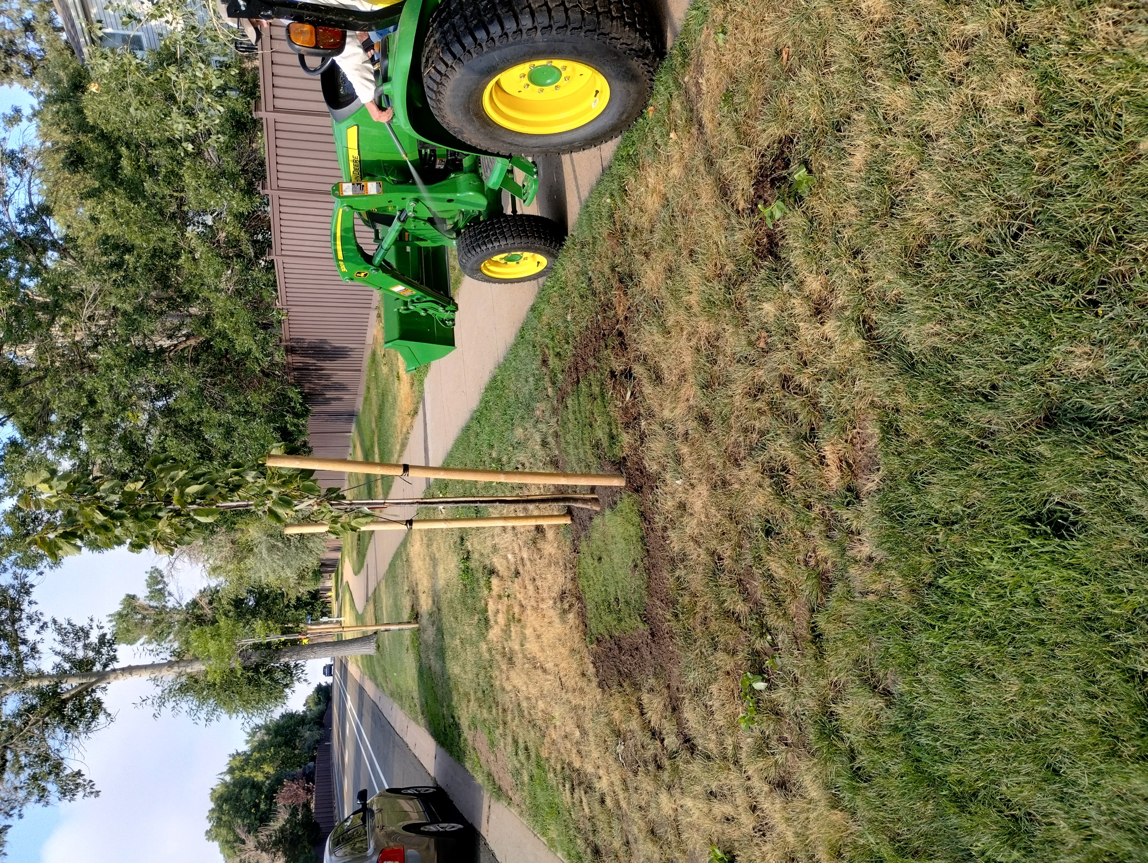
Thursday, July 17, John Bofenkamp using sprayer to add 10 gallons of treated water to each of 3 trees.

Slide 8
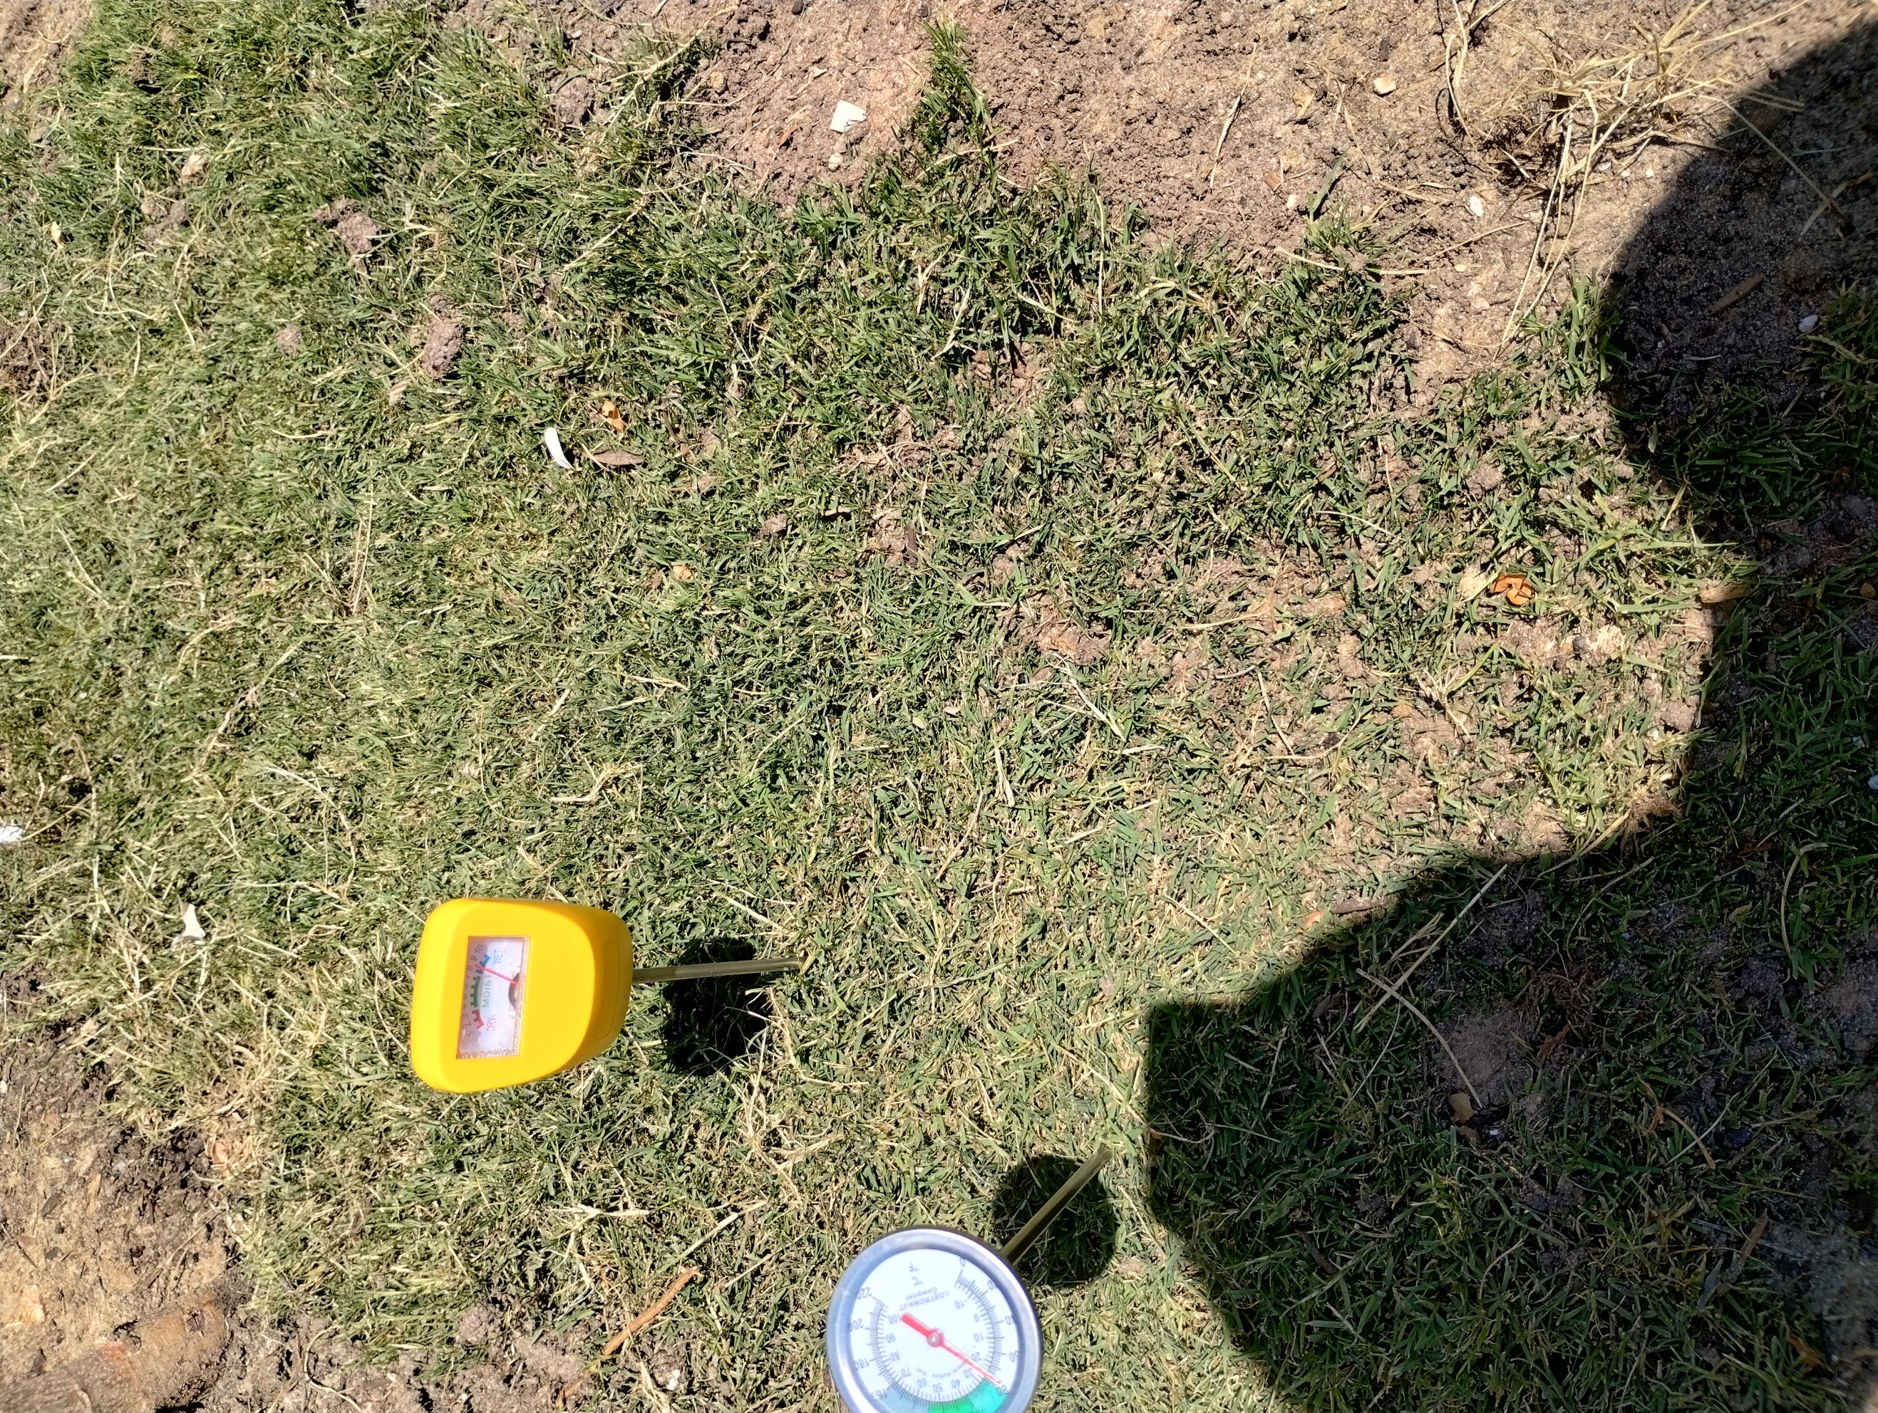
Friday, July 18, 12-inch subsurface thermometer and moisture sensor. Moisture sensor reads from 0, very dry, to 10, very wet.

Slide 9
Wednesday, July 16, 2025 – Before addition of soil amendments and Tahoma 31 grass mats
Air Temperature 72⁰ (11:25 A.M.)
Redmond Linden (North)
Subsurface Soil Temp: 74º
Moisture: Low - 1.5, drooping leaves
Greenspire Linden (South)
Subsurface Soil Temp: 71º
Moisture: High - 7.5

Slide 10
Friday, July 18, 2025 – Temperature & Moisture Readings:
Air Temperature 82⁰ (11:40 A.M.)
Grass Soil Readings:
  Redmond Linden (North)
Subsurface Soil Temp: 78º
Moisture: High - 10, drooping leaves
  Greenspire Linden (South)
Subsurface Soil Temp: 80º
Moisture: High - 7.5

Slide 11
Friday, July 18, 2025 (cont.) – Temperature & Moisture Readings:
Grass Soil Readings:
  Kentucky Coffee Tree (MIddle)
Subsurface Soil Temp: 78º
Moisture: Low – 4.5
Tree Soil Readings:
  Greenspire Linden (South)
Subsurface Soil Temp: 80º
Moisture: Low – 3.0

Slide 12
Saturday, July 19, 2025 – Air Temperature Readings: 82º , 3 P.M.
Grass Soil Readings:
  Redmond Linden (North): Subsurface Soil Temp: 78º / Moisture: High – 10; Drooping leaves
  Greenspire Linden (South): Subsurface Soil Temp: 76º / Moisture: High – 10
  Kentucky Coffee (Middle): Subsurface Soil Temp: 78º / Moisture: Low – 4.5

Slide 13
Saturday, July 19, 2025 (cont.) – Air Temperature Readings: 82º , 3 P.M.
Tree Soil Readings:
  Redmond Linden (North): Subsurface Soil Temp: 82º / Moisture: – Medium – 5.0
  Greenspire Linden (South): Subsurface Soil Temp: 78º / Moisture: Low – 0

Slide 14
Sunday, July 20, 2025 – Air Temperature Readings: 82º , 11 A.M.
Grass Soil Readings:
  Redmond Linden (North): Subsurface Soil Temp: 78º / Moisture: High – 10; Drooping leaves
  Greenspire Linden (South): Subsurface Soil Temp: 78º / Moisture: High – 10
  Kentucky Coffee (Middle): Subsurface Soil Temp: 78º / Moisture: Low – 4.5

Slide 15
Sunday, July 20, 2025 (cont.)
Tree Soil Readings:
  Redmond Linden (North): Subsurface Soil Temp: 80º / Moisture: – Low – 4.0

Slide 16
Monday, July 21, 2025 – Air Temperature Readings: 91º , 1 P.M.
Grass Soil Readings:
  Redmond Linden (North): Subsurface Soil Temp: 80º / Moisture: High – 10; Drooping leaves
  Greenspire Linden (South): Subsurface Soil Temp: 81º / Moisture: High – 10
  Kentucky Coffee (Middle): Subsurface Soil Temp: 78º / Moisture: Medium – 5.0

Slide 17
Monday, July 21, 2025 (cont.)
Tree Soil Readings:
  Greenspire Linden (South): Subsurface Soil Temp: 80º / Moisture: – Low – 2.0

Slide 18
THE DATA:
Date | 7/18/2025 | 7/19/2025 | 7/20/2025 | 7/21/2025
Time | 11:40 AM | 3:00 PM | 11:00 AM | 1:00 PM
Air Temperature | 82 | 82 | 82 | 91
GRASS SOIL READINGS
Redmond Linden (North)
Subsurface Soil Temperature | 78 | 78 | 78 | 80
Moisture | High - 10 | High - 10 | High - 10 | High - 10
Leaves | Drooping | Drooping | Drooping | Drooping
Greenspire Linden (South)
Subsurface Soil Temperature | 80 | 76 | 78 | 81
Moisture | High - 7.5 | High - 10 | High - 10 | High - 10
Leaves
Kentucky Coffee Tree (Middle)
Subsurface Soil Temperature | 78 | 78 | 78 | 78
Moisture | Low - 4.5 | Low - 4.5 | Low - 4 | Med - 5
Leaves
TREE SOIL READINGS
Redmond Linden (North)
Subsurface Soil Temperature |  | 82 | 80
Moisture |  | Med - 5 | Low - 4
Greenspire Linden (South)
Subsurface Soil Temperature | 80 | 78 |  | 80
Moisture | Low - 3 | Low - 0
Kentucky Coffee Tree (Middle)
Subsurface Soil Temperature
Moisture

Slide 19
COMMENTS:
7/18/25 Fri: Added 0.5 gallons of water to both Linden trees’ grass because grass had dry appearance despite high subsurface moisture content.
7/19/25 Sat: Added 5 total gallons of water to all 3 trees’ adjacent grass because grass had dry appearance despite high subsurface moisture content.
7/20/25 Sun: Added 0.5 gallons of water to North Redmond Linden tree because it had low moisture.
7/21/25 Mon: No water was added to the 2 Linden trees because the moisture level was remaining high from the previous day. Please note soil temperatures remain constant despite higher air temperature.

Slide 20
SPECIAL THANKS:
I want to thank Sarah Burnett from Texas Earth, Matt Murgo from Terre Tech, and David Schlup from ScienTurfic Sod for providing all 3 components at no charge to conduct these tests. I also want to thank Tom Mehl and John Bofenkamp for their help with planting the turf mats.

